Slide 1

CIRCULAR ECONOMY FOR BUILDING MATERIALS
Speelman Babette, Ricca Aaron, Giamboni Nicola, Balsiger Reto
Project Presentation · Group 4

Slide 2

1 — INTRODUCTION
The Challenge
Today situation:
Construction sector responsible for most produced waste
Buildings demolished, not disassembled.
Materials crushed and landfilled
35%+
of all EU waste
comes from construction
& demolition activity
500 M
tonnes / year
Why it matters now?
Raw materials are becoming scarcer and costlier
Significant waste
CO2 Emissions
of construction debris
generated in the EU alone
1
material,
once
Most components are used
once, then landfilled for good
Speelman Babette, Ricca Aaron, Giamboni Nicola, Balsiger Reto
02

Slide 3








2 — THE IDEA
From a Straight Line to a Loop
TODAY — LINEAR SYSTEM
Extract raw
material
Build
Demolish
Landfill
GOAL — CIRCULAR SYSTEM
Extract
Build
Disassemble
Sort &
grade parts
Reuse and rebuild
Speelman Babette, Ricca Aaron, Giamboni Nicola, Balsiger Reto
04

Slide 4



3 — HOW IT WORKS
Design for Disassembly
Design buildings so they can be taken apart at end of life.
Every component should become a traceable, reusable part.
Reversible connections
Material passports
Materials as a bank
Bolted, screwed and clamped joints instead of glue and welds.
A tag on every component links to its origin, composition and condition, this makes it traceable fore the future.
At end of life, a building becomes a catalogue of ready-to-use parts for the next one.
Speelman Babette, Ricca Aaron, Giamboni Nicola, Balsiger Reto
03

Slide 5

4 — HOW IT WORKS
The Material Passport
Why it pays off
Steel Beam · Unit #B-114
~1.8–2 t CO₂
Tagged with QR / RFID at installation
MATERIAL
Structural steel, S355
Saved per ton of steel reused
That's equivalent to burn 1.5 cubic meter of coal
MANUFACTURED/INSTALLED
11.2013 / 09.2014
One scanned tag replaces days of manual material testing before reuse
Buyers and demolition crews see reuse value before a single wall comes down
A searchable material database turns a building into a searchable inventory
DIMENSIONS W/H/L
215 x 215 x 440
USED FOR
Structural load-bearing
METHOD OF FIXING
Bolted connection
Speelman Babette, Ricca Aaron, Giamboni Nicola, Balsiger Reto
05

Slide 6




4 — IMPACT
Sustainability Impact
Environmental
Social
Economic
Less raw material extraction
Less landfilled debris
Lower embodied carbon per building
New local deconstruction jobs
New skilled trades & training paths
Community material-reuse hubs
Cheaper inputs from reclaimed stock
Resale value for owners at end of life
New reuse-logistics business models
Trade-offs to manage
Higher upfront costs due to more work time for each piece and higher cost in deconstruction, as skilled labour is needed.
Speelman Babette, Ricca Aaron, Giamboni Nicola, Balsiger Reto
06

Slide 7

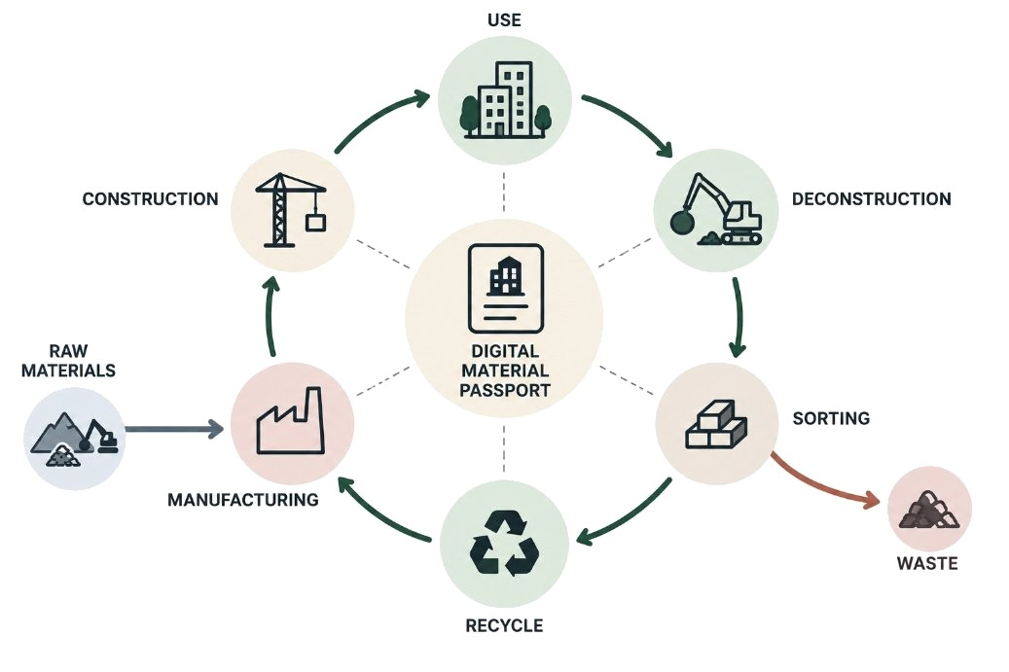
5 — IMPLEMENTATION
Making It Real
Possible solution: Digital Material Passports
Who needs to be involved
Government
Architects and engineers
Material producers
Deconstruction company's
Logistics & storage
Obstacles & bottlenecks
Information
Quality & certification
Economics
Speelman Babette, Ricca Aaron, Giamboni Nicola, Balsiger Reto
07

Slide 8
6 — TAKE-HOME MESSAGE
Every building we put up today
is tomorrow’s material bank.
If we design for disassembly instead of demolition, we stop treating buildings as waste-in-waiting — and start treating them as the raw material for what we build next.
Thank you
Speelman Babette, Ricca Aaron, Giamboni Nicola, Balsiger Reto

